Slide 1
Introduction to
Artificial Intelligence
Lecture: Logical Agents

Slide 2
Outline
Knowledge-Based Agents
Logic
Propositional Logic
Propositional Theorem Proving
Effective Propositional Model Checking

Slide 3
Knowledge-based agents
Supported by logic – a general class of representation
Combine and recombine information to suit myriad purposes
Knowledge base (KB): A set of sentences or facts
Each sentence represents some assertion about the world.
Axiom = the sentence that is not derived from other sentences
Inference: Derive (infer) new sentences from old ones
Add new sentences to the knowledge base and query what is known

Slide 4
Knowledge-based agents
function KB-AGENT(percept) returns an action
persistent: KB, a knowledge base
t, a counter, initially 0, indicating time
TELL(KB, MAKE-PERCEPT-SENTENCE(percept, t))
action ← ASK(KB, MAKE-ACTION-QUERY(t))
TELL(KB, MAKE-ACTION-SENTENCE(action, t))
t ← t + 1
return action
Inference mechanisms are hidden inside TELL and ASK

Slide 5
Logic
Logics are formal languages for representing information such that conclusions can be drawn
Syntax defines the well-formed sentences in the language
Semantics define the "meaning" of sentences
Models are mathematical abstractions that fix the truth or falsehood of every relevant sentence.
𝑚 satisfies (or is a model of) 𝛼 if 𝛼 is true in model 𝑚
𝑀(𝛼) = the set of all models of 𝛼

Slide 6
Entailment
A sentence follows logically from another sentence: 𝜶 ⊨ 𝜷
𝜶 ⊨𝜷 if and only if, in every model in which 𝜶 is true, 𝜷 is also true.
𝑀(𝛼) ⊆ 𝑀(𝛽)
𝑥 = 0 entails 𝑥𝑦 = 0
Entailment is a relationship between sentences that is based on semantics.

Slide 7
Logical inference
𝐾𝐵 ⊨_{𝑖} 𝛼 means 𝛼 can be derived from 𝐾𝐵 by procedure 𝑖.
Soundness: 𝑖 is sound if whenever 𝐾𝐵 ⊨_{𝑖} 𝛼, it is also true that 𝐾𝐵 ⊨ 𝛼
Completeness: 𝑖 is complete if whenever 𝐾𝐵 ⊨ 𝛼, it is also true that 𝐾𝐵 ⊨_{𝑖} 𝛼

Slide 8
World and representation
The reasoning agent gets its knowledge about the facts of the world as a sequence of logical sentences
Conclusions must be drawn only from those → without agent’s independent access to the world
Thus it is very important that the agent’s reasoning is sound.

Slide 9
Propositional Logic: Syntax
Propositional logic: the simplest logic illustrating basic ideas
Constants: TRUE or FALSE
Symbols stand for propositions (sentences): 𝑃, 𝑄, 𝑃, 𝑊, etc.
Logical connectives
Literal: atomic sentence (P) or negated atomic sentence (P)
NOT | ¬ | Negation
AND | ∧ | Conjunction
OR | ∨ | Disjunction
IMPLIES | ⇒ | Implication (if..then)
IFF | ⟺ | Equivalence, biconditional

Slide 10
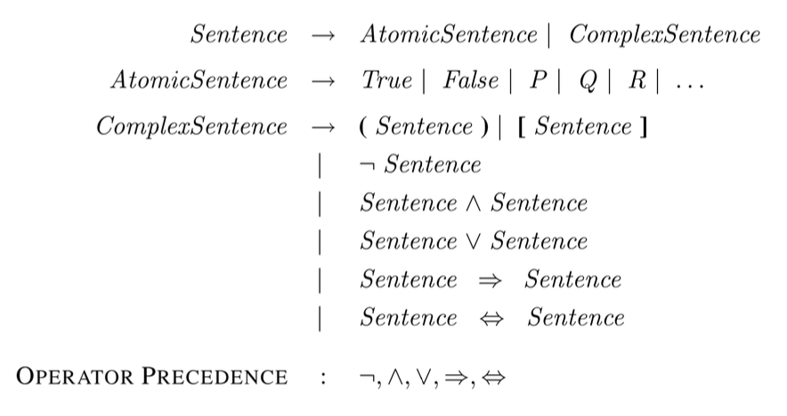
Propositional Logic: Syntax

Slide 11
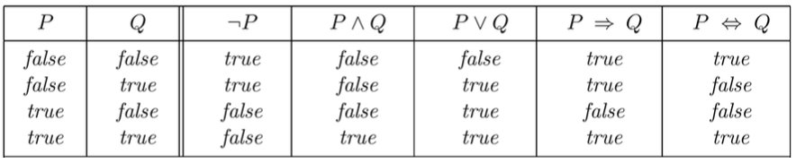
Semantics
Each model specifies true/false for each proposition symbol

Slide 12
A simple inference procedure
Given: a set of sentences, 𝑲𝑩, and sentence 𝜶
Goal: answer 𝑲𝑩 ⊨ 𝜶? = “Does 𝑲𝑩 semantically entail 𝜶?”
Approaches
Model-checking approach (Inference by enumeration)
Inference rules
Conversion to the inverse SAT problem (Resolution refutation)

Slide 13
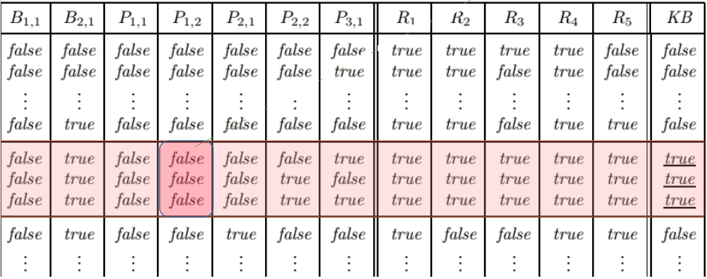
Model-checking approach
Check if 𝛼 is true in every model in which 𝐾𝐵 is true
Draw a truth table for checking

Slide 14
Inference by (depth-first) enumeration
function TT-ENTAILS?(KB, α) returns true or false
inputs: KB, the knowledge base, a sentence in propositional logic
α, the query, a sentence in propositional logic
symbols ← a list of the proposition symbols in KB and α
return TT-CHECK-ALL(KB, α, symbols, { })
function TT-CHECK-ALL(KB, α, symbols, model) returns true or false
if EMPTY?(symbols) then
if PL-TRUE?(KB, model) then return PL-TRUE?(α, model)
else return true // when KB is false, always return true
else do
P ← FIRST(symbols)
rest ← REST(symbols)
return (TT-CHECK-ALL(KB,α,rest,model ∪ {P = true})
and TT-CHECK-ALL(KB,α,rest,model ∪ {P = false}))

Slide 15
Model-checking approach
Given a KB containing the following rules and facts
R1: IF hot AND smoky THEN fire
R2: IF alarm_beeps THEN smoky
R3: IF fire THEN sprinklers_on F1: alarm_beeps
F2: hot
Represent the KB in propositional logic with given symbols
H = hot, S = smoky, F = fire, A = alarms_beeps,
R = sprinklers_on
Answer the question “Sprinklers_on?” by using the model- checking approach.

Slide 16
Inference rules approach
Theorem proving: Apply rules of inference directly to the sentences in KB to construct a proof of the desired sentence without consulting models

Slide 17
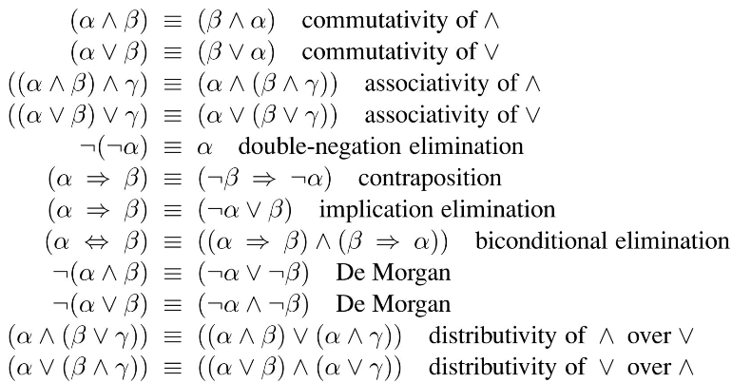
Logical equivalence
Two sentences 𝛼 and 𝛽 are logically equivalent if they are true in the same set of models.
𝜶 ≡ 𝜷 𝒊𝒇𝒇 𝜶 ⊨ 𝜷 𝒂𝒏𝒅 𝜷 ⊨ 𝜶

Slide 18
Validity
A sentence is valid if it is true in all models.
Valid sentences are also known as tautologies.
Validity is connected to inference via the Deduction Theorem
𝛼 ⊨ 𝛽 𝑖𝑓𝑓 𝛼 ⇒ 𝛽 𝑖𝑠 𝑣𝑎𝑙𝑖𝑑

Slide 19
Satisfiability
A sentence is satisfiable if it is true in some model.
A sentence is unsatisfiable if it is true in no models.
Satisfiability is connected to inference via the following
𝛼 ⊨ 𝛽 𝑖𝑓𝑓 𝛼 ∧ ¬𝛽 𝑖𝑠 𝑢𝑛𝑠𝑎𝑡𝑖𝑠𝑓𝑖𝑎𝑏𝑙𝑒
→ Refutation or proof by contradiction
The SAT problem determines the satisfiability of sentences in propositional logic (NP-complete).

Slide 20
Validity and Satisfiability
1. 𝐴 ∨ 𝐵 ⇒ 𝐴 ∧ 𝐶
2. 𝐴 ∧ 𝐵 ⇒ 𝐴 ∨ 𝐶
3. (𝐴 ∨ 𝐵) ∧ (¬𝐵 ∨ 𝐶) ⇒ 𝐴 ∨ 𝐶
4. (𝐴 ∨ ¬𝐵) ⇒ 𝐴 ∧ 𝐵

Slide 21
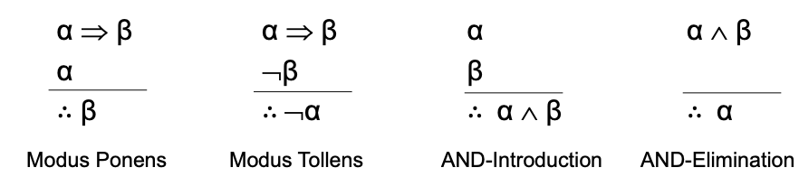
Inference and Proofs
Proof: A chain of conclusions leads to the desired goal

Slide 22
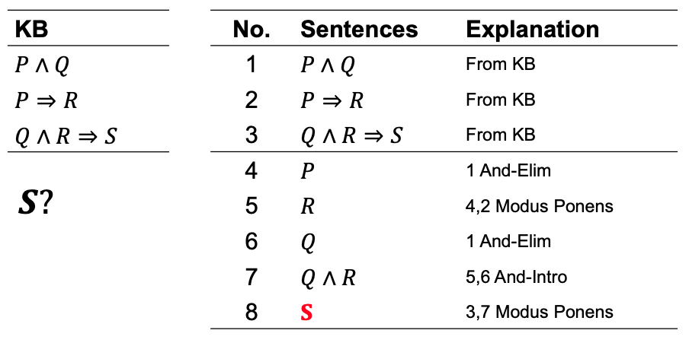
Inference and Proofs

Slide 23
Monotonicity
The set of entailed sentences only increases as information is added to the knowledge base.
𝑖𝑓 𝐾𝐵 ⊨ 𝛼 𝑡h𝑒𝑛 𝐾𝐵 ∧ 𝛽 ⊨ 𝛼
Additional conclusions can be drawn without invalidating any conclusion 𝛼 already inferred.

Slide 24
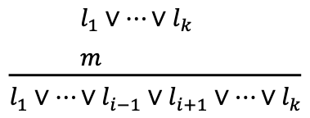
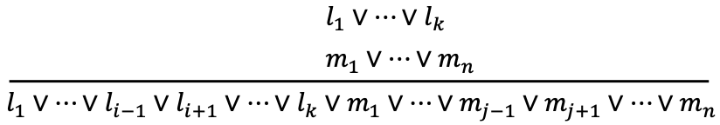
Proof by Resolution
Proof by Inference Rules: sound but not complete
Resolution: sound and complete, a single inference rule
Given 𝑙_{𝑖} and 𝑚 are complementary literals
Unit resolution inference rule
Full resolution rule

Slide 25
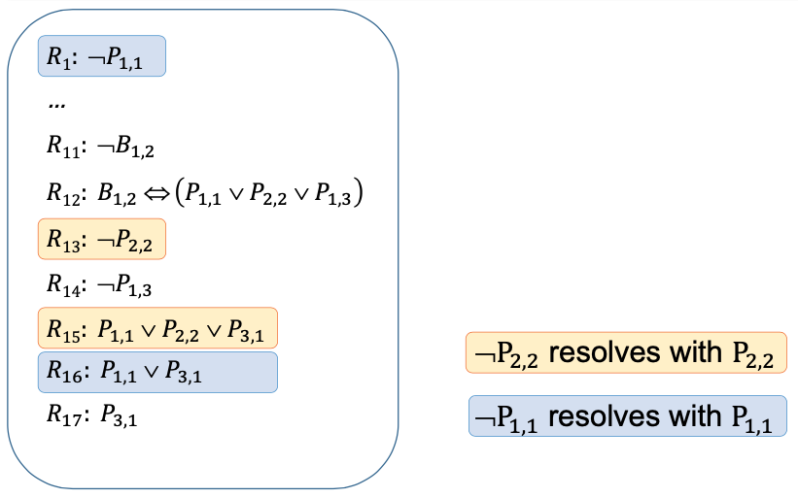
Proof by Resolution

Slide 26
Proof by Resolution
Factoring: the resulting clause should contain only one copy of each literal.
For any sentences 𝛼 and 𝛽 in propositional logic, a resolution-based theorem prover can decide whether 𝛼 ⊨ 𝛽.

Slide 27
Conjunctive Normal Form (CNF)
Resolution applies only to clauses, i.e. disjunctions of literals
Convert all sentences in KB into clauses (CNF form)
For example, convert A ⇔ (B ∨ C) into CNF
(¬A ∨ B ∨ C) ∧ (¬B ∨ A) ∧ (¬C ∨ A )

Slide 28
Conversion to CNF
Eliminate ⇔: 𝛼 ⇔ 𝛽 ≡ 𝛼 ⇒𝛽 ∧ 𝛽 ⇒ 𝛼
Eliminate ⇒: 𝛼 ⇒ 𝛽 ≡ ¬𝛼 ∨ 𝛽
The operator ¬ appears only in literals: “move ¬ inwards”
¬¬𝛼 ≡ 𝛼 (double-negation elimination)
¬(𝛼 ∧ 𝛽) ≡ ¬𝛼 ∨ ¬𝛽 (De Morgan)
¬(𝛼 ∨ 𝛽) ≡ ¬𝛼 ∧ ¬𝛽 (De Morgan)
Apply the distributivity law to distribute ∨ over ∧
(𝛼 ∧ 𝛽) ∨ 𝛾 ≡ (𝛼 ∨ 𝛾) ∧ (𝛽 ∨ 𝛾)

Slide 29
The resolution algorithm
Proof by contradiction: To show that 𝐾𝐵 ⊨ 𝛼, prove 𝐾𝐵 ∧ ¬𝛼 is unsatisfiable
function PL-RESOLUTION(KB, α) returns true or false
inputs: KB, the knowledge base, a sentence in propositional logic
α, the query, a sentence in propositional logic
clauses ← the set of clauses in the CNF representation of KB ∧ ¬α
new ← { }
loop do
for each pair of clauses C_{i}, C_{j} in clauses do
resolvents ← PL-RESOLVE(C_{i} , C_{j})
if resolvents contains the empty clause then return true
new ← new ∪ resolvents
if new ⊆ clauses then return false
clauses ← clauses ∪ new

Slide 30
Horn clauses and Definite clauses
Definite clause: a disjunction of literals of which exactly one is positive.
Horn clause: a disjunction of literals of which at most one is positive.
Goal clause: clauses with no positive literals

Slide 31
KB of definite clauses
KB containing only definite clauses are interesting.
Every definite clause can be written as an implication.
Inference can be done with forward-chaining and backward- chaining algorithms.
Deciding entailment can be done in linear time.

Slide 32
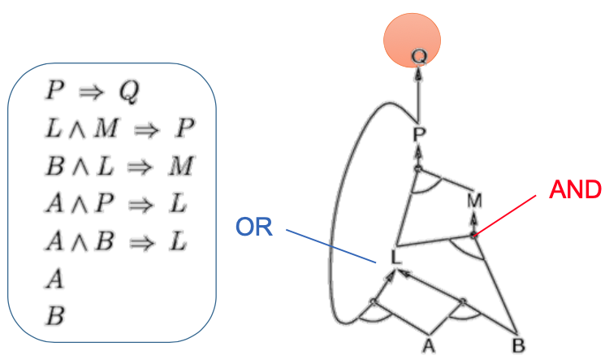
Forward chaining
Key idea: Fire any rule whose premises are satisfied in the KB, add its conclusion to the KB, until the query is found.

Slide 33
Forward chaining
function PL-FC-ENTAILS?(KB, q) returns true or false
inputs: KB, the knowledge base, a set of propositional definite clauses
q, the query, a proposition symbol
count ← a table, where count[c] is the number of symbols in c’s premise
inferred ← a table, where inferred[s] is initially false for all symbols
agenda ← a queue of symbols, initially symbols known to be true in KB
while agenda is not empty do
p ← POP(agenda)
if p = q then return true
if inferred[p] = false then
inferred[p] ← true
for each clause c in KB where p is in c.PREMISE do
decrement count[c]
if count[c] = 0 then add c.CONCLUSION to agenda
return false

Slide 34
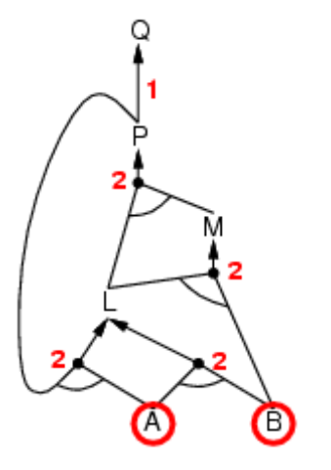
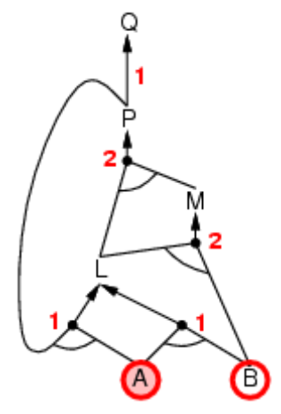
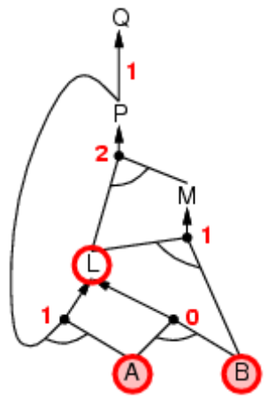
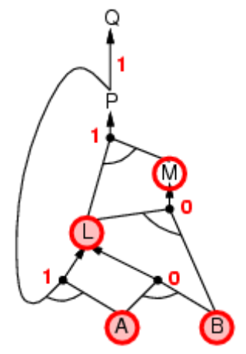
Forward chaining

Slide 35
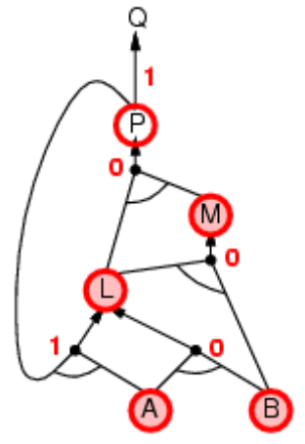
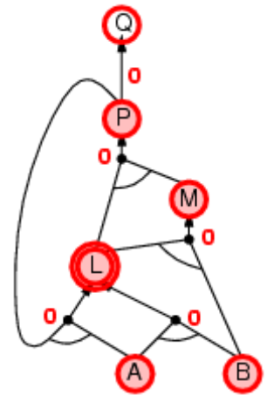
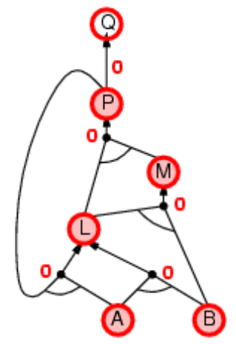
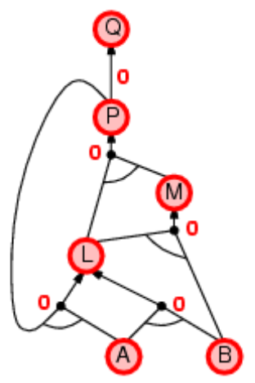
Forward chaining

Slide 36
Backward chaining
Key idea: Work backwards from the query 𝒒
Avoid loops: A new subgoal is already on the goal stack?
Avoid repeated work: A new subgoal has already been proved true, or has already failed?

Slide 37
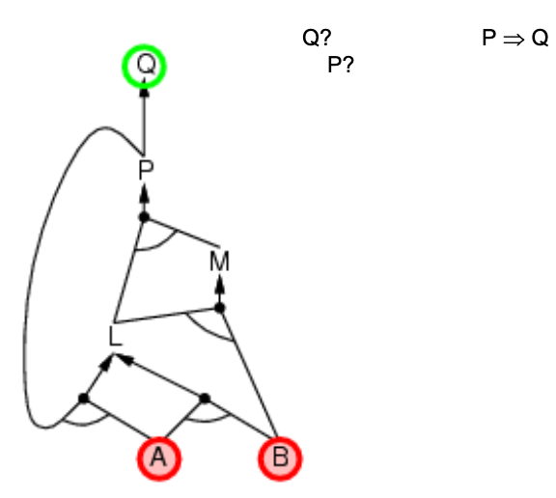
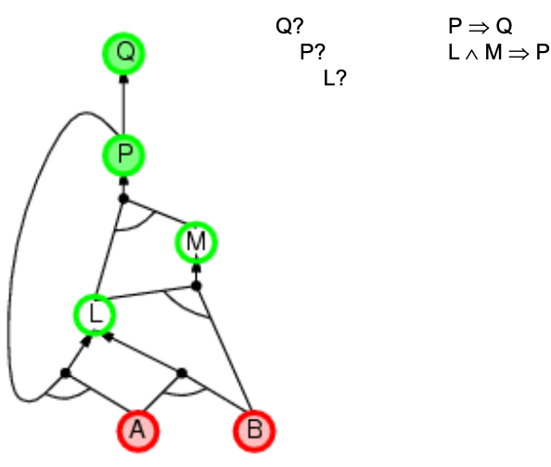
Backward chaining

Slide 38
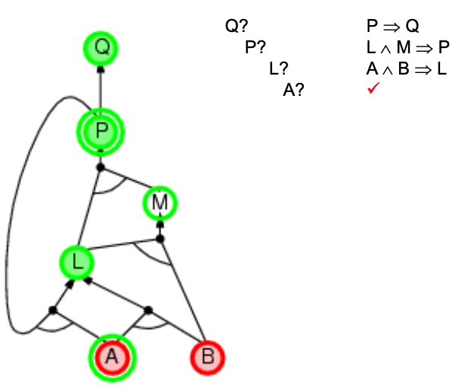
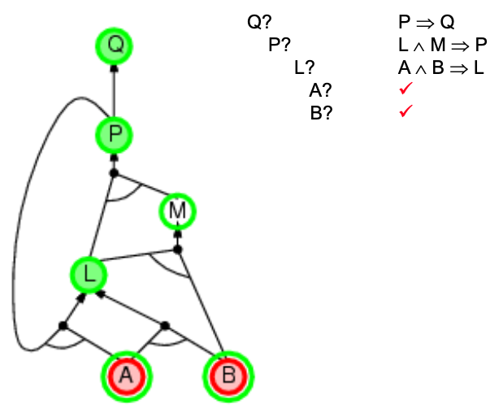
Backward chaining

Slide 39
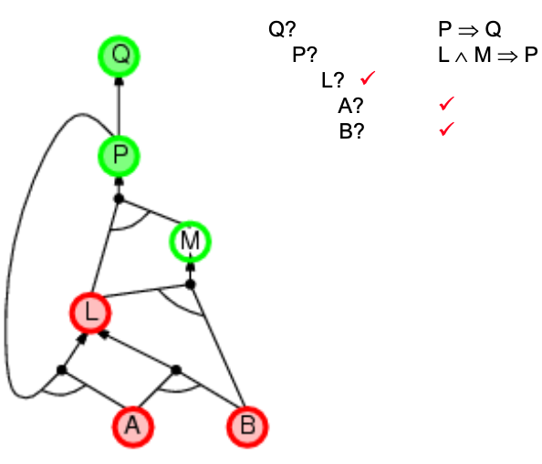
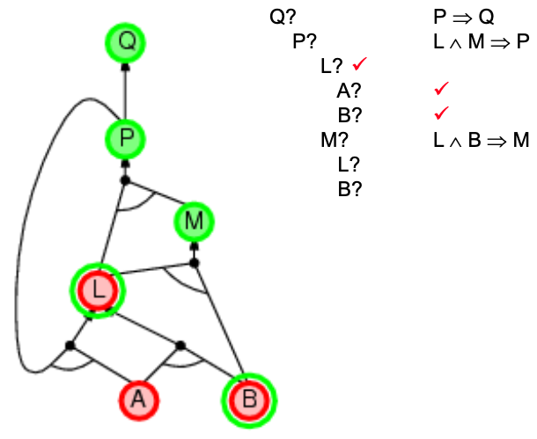
Backward chaining

Slide 40
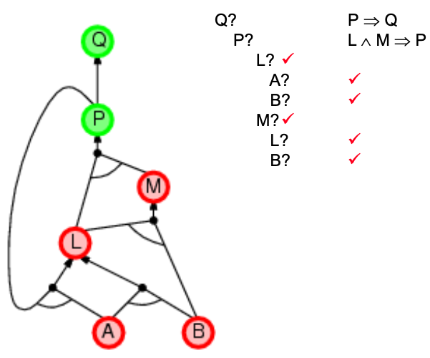
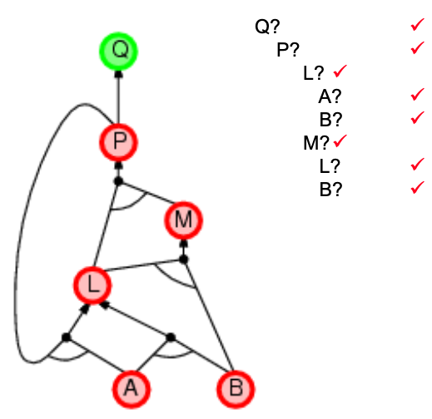
Backward chaining

Slide 41
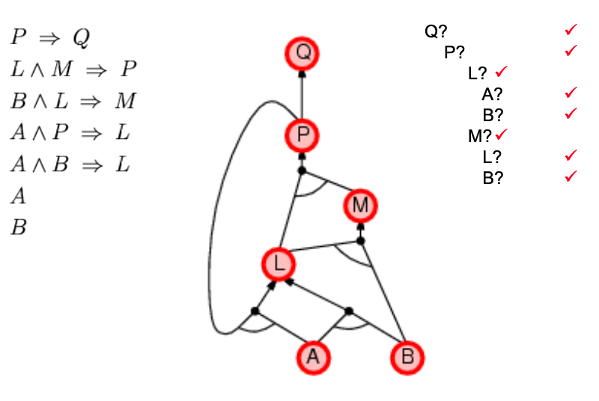
Backward chaining

Slide 42
Forward vs. Backward chaining
Forward chaining: data-driven, automatic, unconscious processing
Backward chaining: goal-driven, good for problem-solving

Slide 43
Efficient propositional inference
The SAT problem (checking satisfiability)
Testing entailment, 𝛼 ⊨ 𝛽? = testing unsatisfiability of 𝛼 ∧ ¬𝛽
Two families of efficient algorithms for general propositional inference based on model checking
Complete backtracking search algorithms
DPLL algorithm (Davis, Putnam, Logemann, Loveland)
Incomplete local search algorithms(hill-climbing)
WalkSAT algorithm

Slide 44
The DPLL algorithm
Determine whether an input propositional logic sentence (in CNF) is satisfiable
Improvements over truth table enumeration
1. Early termination
2. Pure symbol heuristic
3. Unit clause heuristic

Slide 45
The DPLL algorithm
Early termination: A clause is true if any literal is true and a sentence is false if any clause is false.
Pure symbol heuristic: A pure symbol always appears with the same "sign" in all clauses.
Unit clause heuristic: there is only one literal in the clause and thus this literal must be true

Slide 46
The DPLL algorithm
function DPLL-SATISFIABLE?(s)
returns true or false
inputs: s, a sentence in propositional logic
clauses ← the set of clauses in the CNF representation of s symbols ← a list of the proposition symbols in s
return DPLL(clauses, symbols,{ })

Slide 47
The DPLL algorithm
function DPLL(clauses, symbols, model) returns true or false
if every clause in clauses is true in model then return true
if some clauses in clauses are false in model then return false
P, value ← FIND-PURE-SYMBOL(symbols, clauses, model)
if P is non-null then return DPLL(clauses, symbols – P, model ∪ {P=value})
P, value ← FIND-UNIT-CLAUSE(clauses, model)
if P is non-null then return DPLL(clauses, symbols – P, model ∪ {P=value})
P ← FIRST(symbols)
rest ← REST(symbols)
return DPLL(clauses, rest, model ∪ {P=true})
or DPLL(clauses, rest, model ∪ {P=false}))

Slide 48
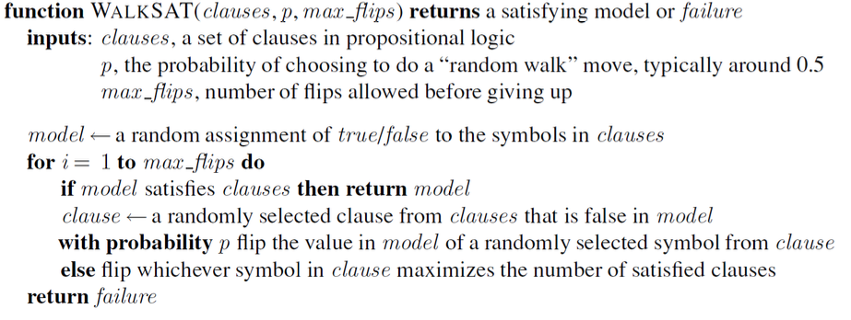
The WalkSAT algorithm
Incomplete, local search algorithm
Evaluation function: The min-conflict heuristic of minimizing the number of unsatisfied clauses
Balance between greediness and randomness

Slide 49
The WalkSAT algorithm
When the algorithm returns a model → The input sentence is indeed satisfiable
When it returns false → The sentence is unsatisfiable OR we need to give it more time
WalkSAT cannot always detect unsatisfiability
It is most useful when a solution is expected to exist

Slide 50
References
Stuart Russell and Peter Norvig. 2009. Artificial Intelligence: A Modern Approach (3rd ed.). Prentice Hall Press, Upper Saddle River, NJ, USA.
Lê Hoài Bắc, Tô Hoài Việt. 2014. Giáo trình Cơ sở Trí tuệ nhân tạo. Khoa Công nghệ Thông tin. Trường ĐH Khoa học Tự nhiên, ĐHQG-HCM.
Nguyễn Ngọc Thảo, Nguyễn Hải Minh. 2020. Bài giảng Cơ sở Trí tuệ Nhân tạo. Khoa Công nghệ Thông tin. Trường ĐH Khoa học Tự nhiên, ĐHQG-HCM.

